Slide 1
Travel Insurance Case Study
Burak Altay
07-2022

Slide 2
Introduction
Analysis of the travel habits of customers in order to use the reduced budgets due to Covid 19 effectively.
Methodology
The data of 1987 customers and non-customers aged between 25-35 are provided for analysis by the company.
Analyzing various characteristics of customers and non-customers such as travel frequency, whether they travel abroad, chronic diseases, occupational conditions, in order to determine the marketing strategy.
For analysis, pandas, matplotlib, seaborn libraries of python programming language were used on Jupyter notebook.

Slide 3
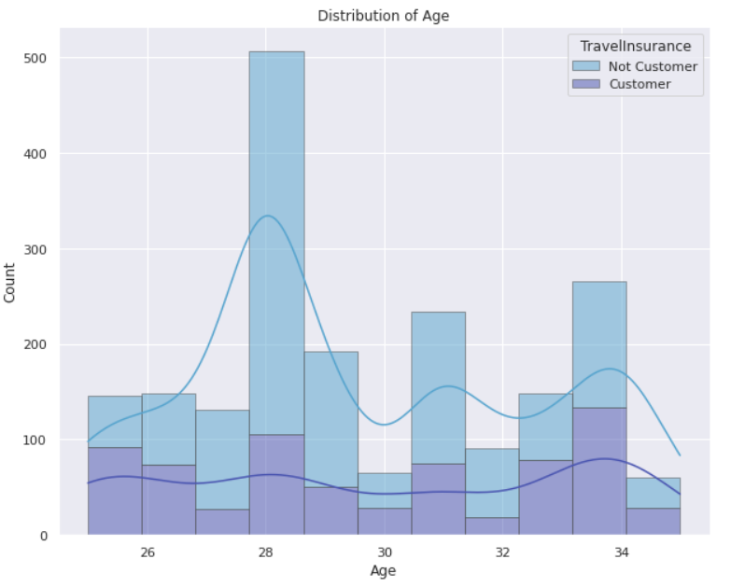
Analysis
1- Distribution of customers and non-customers by age
While the ages vary between 25 and 35, the most customers are among the people who are 35 years old. Although the number of customers who are 28 years old is above the average, the rate of non-customers is much higher than other ages. It is not correct to make a deduction based on age only.

Slide 4
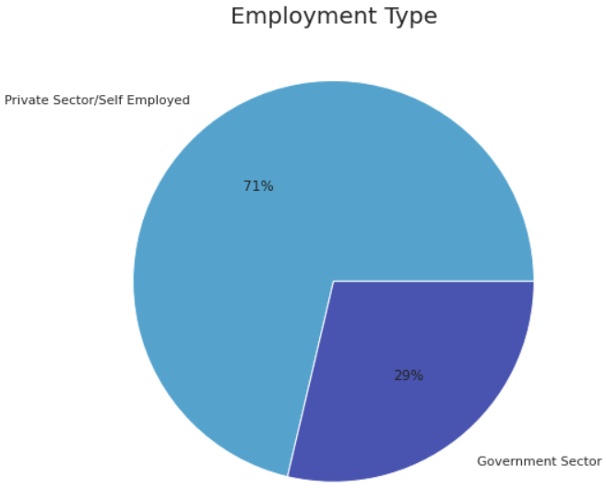
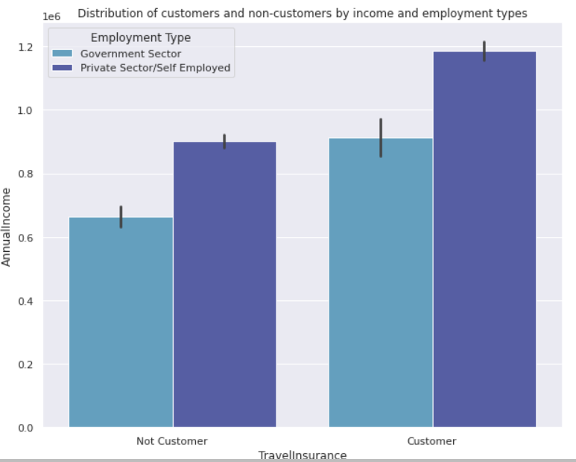
2- Analysis of customers and non-customers by employment type
Most of the people in the data set work in the Private Sector or as Self Employed, while the number of employees in the government sector is less.
While the income of the customers working in the private or public sector is higher than the non-customers, it can be said that the income situation affects the status of being a customer.

Slide 5
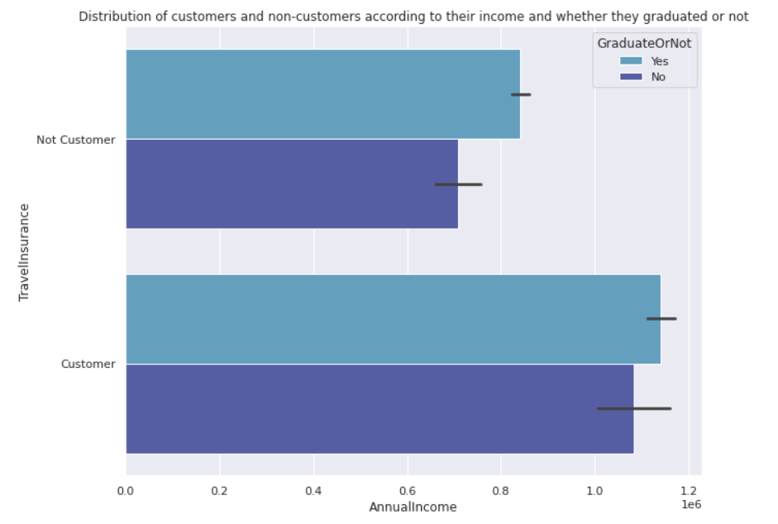
3- Analysis of customers and non-customers by graduation or not
The majority of customers and non-customers are graduates.
While the incomes of graduates and non-graduates are closer to each other, the difference between non-customers is slightly larger.

Slide 6
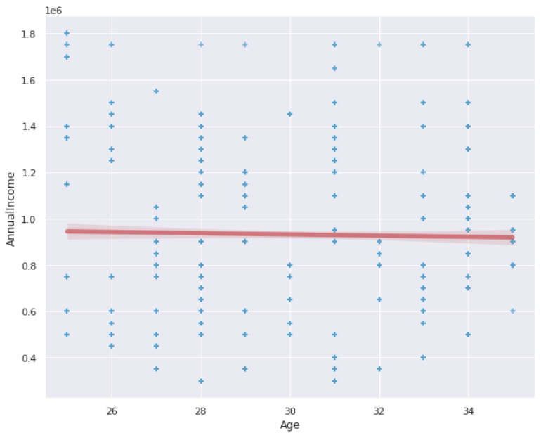
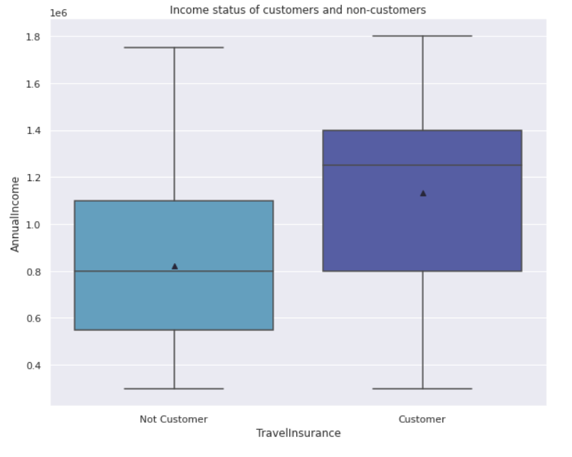
4- Analysis of customers and non-customers by income
It has been observed that as the age of the people in the data set increases, there is a slight decrease in their income status.
Average annual income of customers is higher than average annual income of non-customers.

Slide 7
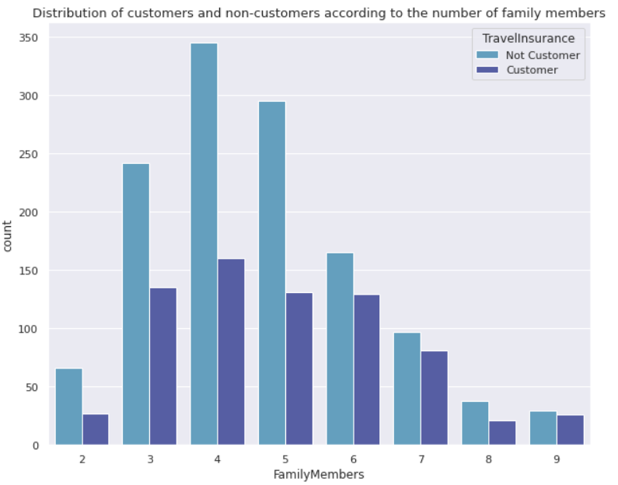
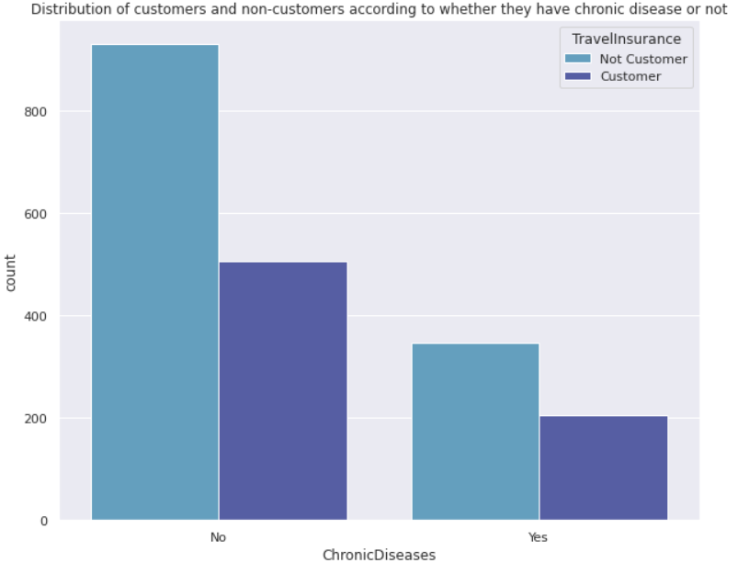
5- Analysis of customers and non-customers by number of family members and chronic disease status
The majority of the person in the data set have families of 3, 4 or 5 members. While the number of families with more than 5 family members is decreasing, it has been observed that the rate of being a customer increases in these families.
The ratio of customers with chronic disease to non-customers is higher than those without chronic disease. Chronic disease increases the tendency to become a customer.

Slide 8
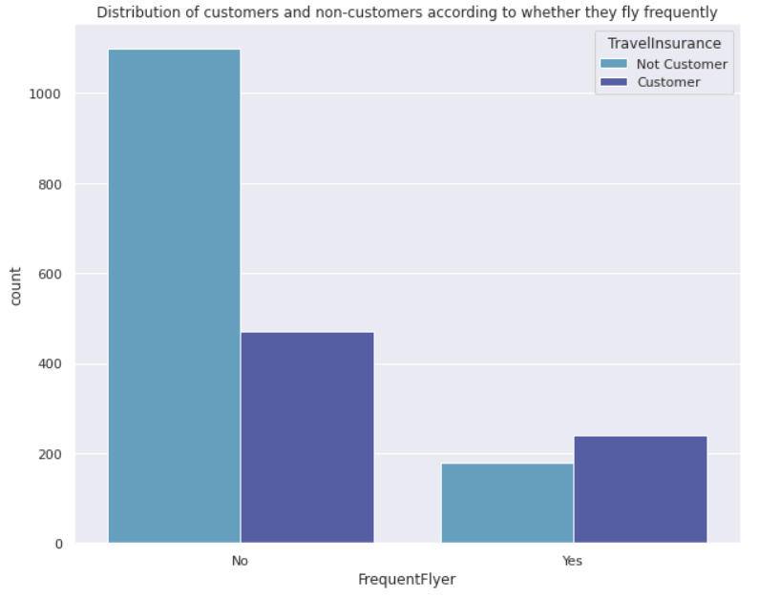
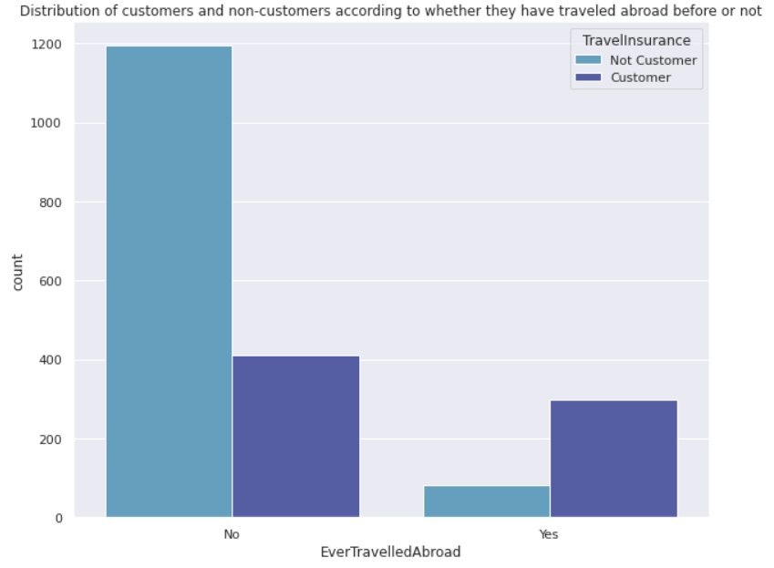
6- Analysis of customers and non-customers by travel habits
The majority of customers have traveled abroad before and travel more often than non-customers.
While the rate of frequent flyer customers is higher than frequent flyer customers, this rate is much higher for non-frequent customers than non-frequent customers.

Slide 9
Conclusion
Customers have a higher average annual income than non-customers, and this affects customer status.
Frequent flyers tend to be more customers. However, the majority of those who travel abroad are not customers.
The proportion of non-customers in families with few members is higher than in families with many members.

